Slide 1

BANASTHALI VIDYAPITH
Department of Computer Science
Session: 2023-24
SARCASM DETECTION
Using Contextual Embeddings

Slide 2
GroupID: CSIT6
Aahna Sethi
2116091
Bachelor of Technology in Computer Science
Akanksha Sharma
2116728
Bachelor of Technology in Information Technology
Ananya Singh Gautam
2116104
Bachelor of Technology in Computer Science
Sakshi
2116814
Bachelor of Technology in Information Technology

Slide 3
What is Sarcasm?
Why is it necessary?
Literature Review
Research Gap
Content
Objectives
Methodology
Corpus Creation
Extraction of factors
Deep Learning Model
Evaluation
Tools and Techniques
Expected Outcomes

Slide 4

What is Sarcasm?
Sarcasm is speech or writing which actually means the opposite of what it seems to say.
Example:
Sarcastic-‘I love working on Sunday!’
Non-Sarcastic-‘I love Friday.’

Slide 5

Why is it necessary?
Sarcasm detection is vital for ensuring precise understanding of sentiments in social media and customer reviews.
It enhances natural language understanding, improving AI models' comprehension of language nuances.
In social interactions and customer service, detecting sarcasm prevents misunderstandings, enhancing communication quality.

Slide 6
Literature Review
S. No. | Author | Work Done | Accuracy
1. | Zhang et al. (2016) | Explored the application of a neural network for detecting sarcasm in tweets. | 90.74%
2. | Bamman and Smith (2015) | Emphasised sarcasms dependence on shared knowledge between speakers and audiences, highlighting its contextual nature. | 85.1%
3. | Bharti et al. (2017) | Proposed a hyperbolic feature-based sarcasm detector for Twitter data. | 80.79%

Slide 7
S. No | Author | Work Done | Accuracy
4. | Bedi et al. (2021) | Researched on the Hindi-English code-mixed conversational dialog. | 84%
5. | Nagwanshi and Madhavan (2014) | Presented an innovative approach for detecting sarcasm in text, focusing on key features such as semantic content and sentiment reversal. | 74%
6. | Razali et al. (2021) | Focused on spotting sarcasm in tweets using a combination of deep learning features and carefully crafted features related to the tweet's context. | 70.2%

Slide 8
Research Gaps
Enhancing the performances of sentiment analysis and opinion mining is still one of the goals.
Explore new ways to identify stereotypical negative activity because this type of
world knowledge is essential to analyse sarcasm.
Integration of linguistic and cognitive features is needed to improve the performance of models.
Research on automatic annotation of models to detect more sarcastic sentences in different kinds of text is needed.
Recognizing the intensity of the negativity may also be useful to distinguish
strong contrast from weak contrast.
Deep learning approaches were less explored.

Slide 9
Objectives
Corpus creation.
To extract features based on linguistic and cognitive factors.
To train the deep learning model.
To evaluate the model on the basis of precision, recall, f-measures and accuracy.

Slide 10
Methodology
1. Corpus Creation
Used the dataset from MUStARD - Multimodel Sarcasm Detection Dataset - available on GitHub.
It contains dialogues from two popular American sit-com dramas, ‘F.R.I.E.N.D.S.’ and ‘The Big Bang Theory’.
The dataset is a collection of 11424 lines consisting of the utterance, context, characters, and the classification of the model (sarcastic or non-sarcastic).

Slide 11
Example
2. "utterance": "I'd miss you if I broke up with you. Just trying to be supportive.",
"speaker": "CHANDLER",
"context": [
"So Rachel called, wants to see me. Going over in a minute.",
"Wow, what do you think she wants?",
"Well, maybe the crazy fog has lifted and she realizes that life without me a sucks.",
"Its possible, you are very lovable."
],
"show": "FRIENDS",
"sarcasm": false
"utterance": "Uh, so how many cameras
are actually on you.",
"speaker": "CHANDLER",
"context": [
"Where's Monica?",
"Over here Dad",
"How to you zoom out? There she is",
"Some girl ate Monica",
"Shut up, the camera adds 10 pounds."
],
"show": "FRIENDS",
"sarcasm": true

Slide 12
2. Extraction of Features
Flesch-Kincaid Reading Ease Score:
206.835 - (1.015 * Average words per sentence) - (84.6 * Average syllables per word)
Here is an example with a text:
The quick brown fox jumps over the lazy dog.
Count the number of syllables: 14
Count the number of words: 9
Count the number of sentences: 1
Average number of words per sentence: 9
Average number of syllables per word: 1.56
Plug the values into the formula:
206.835 - (1.015 * 9) - (84.6 * 1.56) = 63.3

Slide 13
Gunning Fog Index:
0.4 * (Average words per sentence + Percentage of Complex Words)
Here is an example with a text:
The quick brown fox jumps over the lazy dog.
Count the number of words: 9
Count the number of sentences: 1
Count the number of complex words: 0
Average number of words per sentence: 9
Plug the values into the formula:
0.4 * (9 + 0) = 3.6

Slide 14
3. Deep Learning Model
Deep learning is a branch of machine learning that uses neural networks to analyze and learn from complex and unstructured data.
It facilitates computational models to categorize text, voice, or images, while continually learning from the provided data.
It is trained using neural network topologies with extensive layers and labeled data, can achieve precision surpassing human capabilities.
We shall develop three models
Bidirectional LSTM Model
Deep GRU Model
Transformer Model

Slide 15
4. Evaluation
The models are evaluated using four important measures:
Precision (PRE)
F-measure (F-M)
PRE = TP / (TP + FP)
F1 = 2. (precision * recall) / (precision + recall)
Recall (REC)
Accuracy (ACC)
REC = TP / (TP+FN)
ACC = TP + TN / (TP + TN + FP + FN)

Slide 16


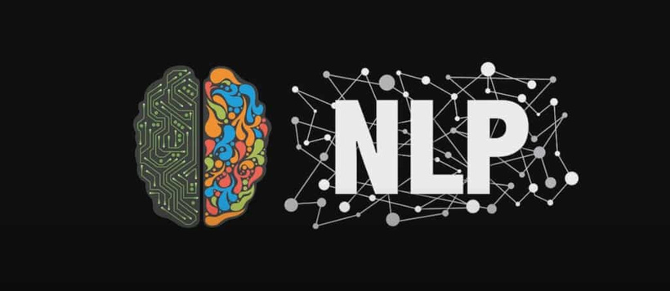





Tools And Techniques
Python
FastText
GloVe
Scikit-Learn,
Tensorflow,
Keras,
Streamlit (for UI)

Slide 17
Expected Outcomes
Develop a web application for implementing contextual embeddings technology.
User inputs sentence, and the application will predict if they are non-sarcastic or sarcastic.
Utilize contextual embeddings to enhance accuracy in classification.

Slide 18
References
Bamman, D., & Smith, N. (2015). Contextualized sarcasm detection on twitter. In proceedings of the international AAAI conference on web and social media (Vol. 9, No. 1, pp. 574-577).
Bedi, M., Kumar, S., Akhtar, M. S., & Chakraborty, T. (2021). Multi-modal sarcasm detection and humor classification in code-mixed conversations. IEEE Transactions on Affective Computing.
Bharti, S. K., Pradhan, R., Babu, K. S., & Jena, S. K. (2017). Sarcasm analysis on twitter data using machine learning approaches. Trends in Social Network Analysis: Information Propagation, User Behavior Modeling, Forecasting, and Vulnerability Assessment, 51-76.
Nagwanshi, P., & Madhavan, C. V. (2014, October). Sarcasm detection using sentiment and semantic features. In International Conference on Knowledge Discovery and Information Retrieval (Vol. 2, pp. 418-424). SCITEPRESS.
Razali, M. S., Halin, A. A., Ye, L., Doraisamy, S., & Norowi, N. M. (2021). Sarcasm detection using deep learning with contextual features. IEEE Access, 9, 68609-68618.
Zhang, M., Zhang, Y., & Fu, G. (2016, December). Tweet sarcasm detection using deep neural network. In Proceedings of COLING 2016, the 26th International Conference on Computational Linguistics: technical papers (pp. 2449-2460).

Slide 19
THANK YOU

